Slide 1
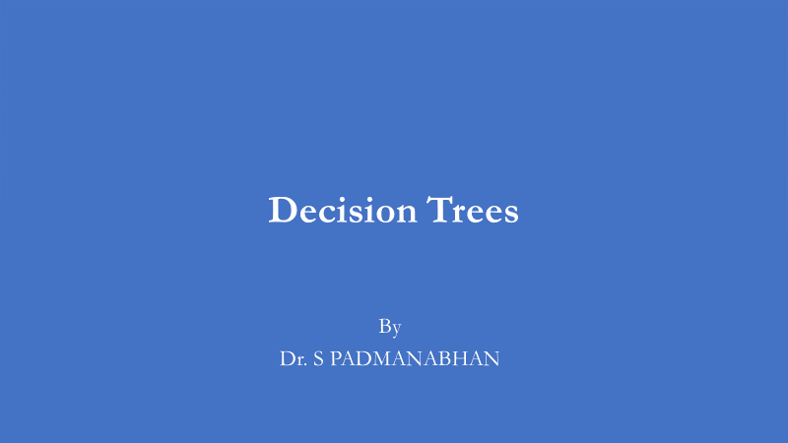

Slide 2
Decision Tree Classification Algorithm
Decision Tree is a Supervised learning technique that can be used for both classification and Regression problems, but mostly it is preferred for solving Classification problems.
It is a tree-structured classifier, where internal nodes represent the features of a dataset, branches represent the decision rules and each leaf node represents the outcome.

Slide 3
Decision Tree Classification Algorithm
In a Decision tree, there are two nodes, which are the Decision Node and Leaf Node.
Decision nodes are used to make any decision and have multiple branches, whereas Leaf nodes are the output of those decisions and do not contain any further branches.
The decisions or the test are performed on the basis of features of the given dataset.

Slide 4
Decision Tree Classification Algorithm
It is a graphical representation for getting all the possible solutions to a problem/decision based on given conditions.
It is called a decision tree because, similar to a tree, it starts with the root node, which expands on further branches and constructs a tree-like structure.
In order to build a tree, we use the CART algorithm, which stands for Classification and Regression Tree algorithm.

Slide 5

Decision Tree Classification Algorithm
A decision tree simply asks a question, and based on the answer (Yes/No), it further split the tree into subtrees.
Below diagram explains the general structure of a decision tree:

Slide 6
Why use Decision Trees?
There are various algorithms in Machine learning, so choosing the best algorithm for the given dataset and problem is the main point to remember while creating a machine learning model. Below are the two reasons for using the Decision tree:
Decision Trees usually mimic human thinking ability while making a decision, so it is easy to understand.
The logic behind the decision tree can be easily understood because it shows a tree-like structure.

Slide 7
Decision Tree Terminologies
Root Node: Root node is from where the decision tree starts. It represents the entire dataset, which further gets divided into two or more homogeneous sets.
Leaf Node: Leaf nodes are the final output node, and the tree cannot be segregated further after getting a leaf node.
Splitting: Splitting is the process of dividing the decision node/root node into sub-nodes according to the given conditions.

Slide 8
Decision Tree Terminologies
Branch/Sub Tree: A tree formed by splitting the tree.
Pruning: Pruning is the process of removing the unwanted branches from the tree.
Parent/Child node: The root node of the tree is called the parent node, and other nodes are called the child nodes.

Slide 9
How does the Decision Tree algorithm Work?
In a decision tree, for predicting the class of the given dataset, the algorithm starts from the root node of the tree. This algorithm compares the values of root attribute with the record (real dataset) attribute and, based on the comparison, follows the branch and jumps to the next node.
For the next node, the algorithm again compares the attribute value with the other sub-nodes and move further. It continues the process until it reaches the leaf node of the tree. The complete process can be better understood using the below algorithm:

Slide 10
Step-1: Begin the tree with the root node, says S, which contains the complete dataset.
Step-2: Find the best attribute in the dataset using Attribute Selection Measure (ASM).
Step-3: Divide the S into subsets that contains possible values for the best attributes.
Step-4: Generate the decision tree node, which contains the best attribute.
Step-5: Recursively make new decision trees using the subsets of the dataset created in step -3. Continue this process until a stage is reached where you cannot further classify the nodes and called the final node as a leaf node.

Slide 11
Attribute Selection Measures
While implementing a Decision tree, the main issue arises that how to select the best attribute for the root node and for sub-nodes. So, to solve such problems there is a technique which is called as Attribute selection measure or ASM. By this measurement, we can easily select the best attribute for the nodes of the tree. There are two popular techniques for ASM, which are:
Information Gain
Gini Index

Slide 12
Entropy
Entropy is one of the criteria used to build the decision tree.
It calculates the heterogeneity of the sample.
The entropy is zero if the sample is completely homogeneous and it is equal to one if the sample is equally divided.
Entropy is calculated using the below formula:

Slide 13
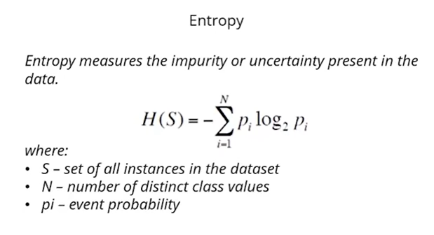

Slide 14
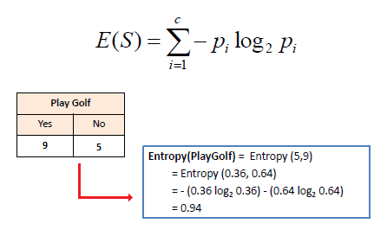

Slide 15
1. Information Gain:
Information gain is the measurement of changes in entropy after the segmentation of a dataset based on an attribute.
It calculates how much information a feature provides us about a class.
According to the value of information gain, we split the node and build the decision tree.
A decision tree algorithm always tries to maximize the value of information gain, and a node/attribute having the highest information gain is split first. It can be calculated using the below formula:

Slide 16
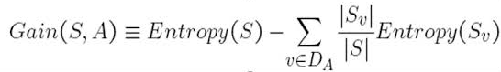

Slide 17
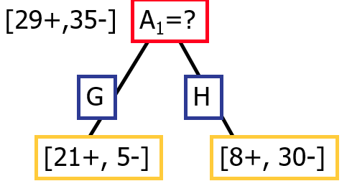
Entropy([29+,35-]) = -29/64*log2 (29/64) – 35/64*log2 (35/64) = 0.99
Entropy([21+,5-]) = -21/26*log2 (21/26) - 5/26*log2 (5/26) = 0.71
Entropy([8+,30-]) = -8/38*log2 (8/38) - 30/38 *log2 (30/38) = 0.74
Information Gain([29+,35-]), A1) = 0.99 - (26/64)*0.71 - (38/64)*0.74 = − 0.15

Slide 18
2. Gini Index:
Gini index is a measure of impurity or purity used while creating a decision tree in the CART(Classification and Regression Tree) algorithm.
The value of the Gini index varies between 0 and 1.
An attribute with the low Gini index should be preferred as compared to the high Gini index.
It only creates binary splits, and the CART algorithm uses the Gini index to create binary splits.
Gini index can be calculated using the below formula:

Slide 19
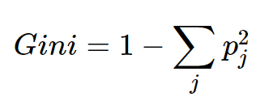

Slide 20


Learning Decision Trees with Supervision
The basic idea is very simple
Recursively partition the training data into homogeneous regions
Within each group, fit a simple supervised learner (e.g., predict the majority label)
What do you mean by “homogeneous” regions?
Even though the rule within each group is simple, we are able to learn a fairly sophisticated model overall (note in this example, each rule is a simple horizontal/vertical classifier but the overall decision boundary is rather sophisticated)
A homogeneous region will have all (or a majority of) training inputs with the same/similar outputs

Slide 21
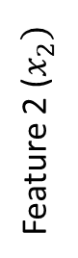
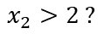
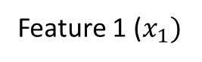
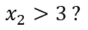
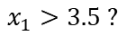
Decision Trees for Classification
5
NO
YES
Test input
$$x_{1}>3.5 ?$$
4
NO
YES
NO
YES
3
$$x_{2}>2 ?$$
$$x_{2}>3 ?$$
2
Predict Red
Predict Green
Predict Green
Predict Red
1
1
2
3
4
5
6
Feature 1 ($x_{1})$
Remember: Root node contains all training inputs
Each leaf node receives a subset of training inputs
DT is very efficient at test time: To predict the label of a test point, nearest neighbors will require computing distances from 48 training inputs. DT predicts the label by doing just 2 feature-value comparisons! Way faster!

Slide 22
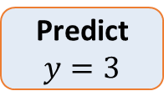
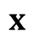
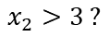
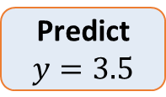
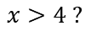
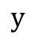
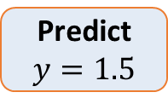
Decision Trees for Regression
Can use any regression model but would like a simple one, so let’s use a constant prediction based regression model
Another simple option can be to predict the average output of the training inputs in this region
4
3
2
1
NO
YES
$$x>4 ?$$
$$y$$
NO
YES
Predict $y=3.5$
$$x_{2}>3 ?$$
Predict $y=3$
Predict $y=1.5$
1 2 3 4 5
$$x$$
To predict the output for a test point, nearest neighbors will require computing distances from 15 training inputs. DT predicts the label by doing just at most feature-value comparisons! Way faster!

Slide 23
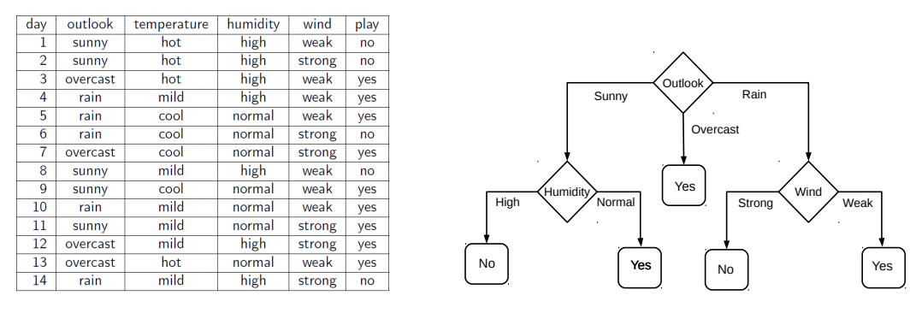
Decision Tree Construction: An Example
Let’s consider the playing Tennis example
Assume each internal node will test the value of one of the features
Question: Why does it make more sense to test the feature “outlook” first?
Answer: Of all the 4 features, it’s the most informative
It has the highest information gain as the root node

Slide 24
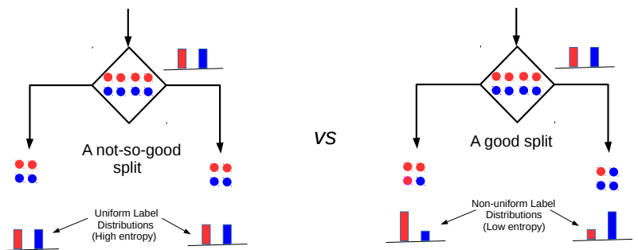
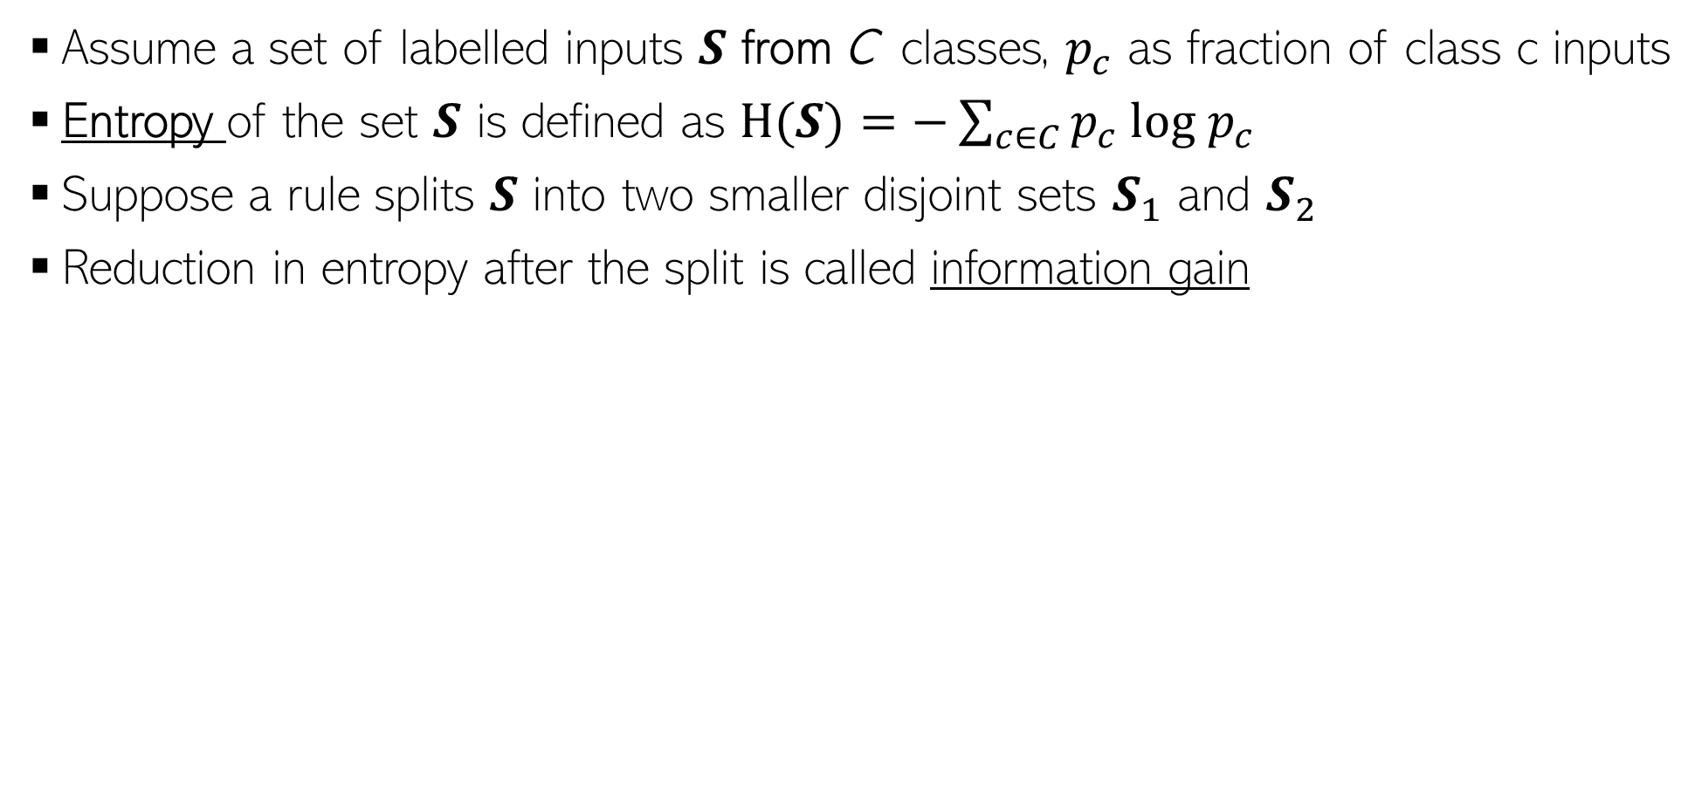
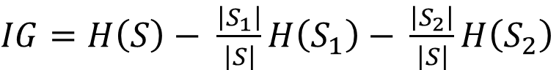
Entropy and Information Gain
Assume a set of labelled inputs $S$ from C classes, $p_{c}$ as fraction of class c inputs
Entropy of the set $S$ is defined as $H(S)=−\sum_{c∈C}{p_{c} log p_{c}}$
Suppose a rule splits $S$ into two smaller disjoint sets $S_{1}$ and $S_{2}$
Reduction in entropy after the split is called information gain
Uniform sets (all classes roughly equally present) have high entropy; skewed sets low
$IG=H\left(S\right)− \frac{\left|S_{1}\right|}{\left|S\right|}H\left(S_{1}\right)$ $− \frac{\left|S_{2}\right|}{\left|S\right|}H\left(S_{2}\right)$
This split has a low IG
(in fact zero IG)
This split has higher IG

Slide 25
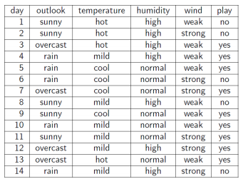
Entropy and Information Gain
Let’s use IG based criterion to construct a DT for the Tennis example
At root node, let’s compute IG of each of the 4 features
Consider feature “wind”. Root contains all examples S = [9+,5-]
S_{weak} = [6+, 2−] ⇒ H(S_{weak} ) = 0.811
S_{strong} = [3+, 3−] ⇒ H(S_{strong}) = 1
Likewise, at root: IG(S, outlook) = 0.246, IG(S, humidity) = 0.151, IG(S, temp) = 0.029
Thus we choose “outlook” feature to be tested at the root node
Now how to grow the DT, i.e., what to do at the next level? Which feature to test next?
Rule: Iterate - for each child node, select the feature with the highest IG
$$\text{H}\text{(}\text{S} \text{) =}\text{ −(9/14) }\text{log}\text{2}\text{(9/14) − (5/14) }\text{lo}\text{g}\text{2}\text{(5/14) = 0.94}$$
$IG(S,wind)=H\left(S\right)− \frac{\left|S_{weak}\right|}{\left|S\right|}H\left(S_{weak}\right)$ $− \frac{\left|S_{strong}\right|}{\left|S\right|}H\left(S_{strong}\right)$ = 0.94 − 8/14 ∗ 0.811 − 6/14 ∗ 1 = 0.048

Slide 26
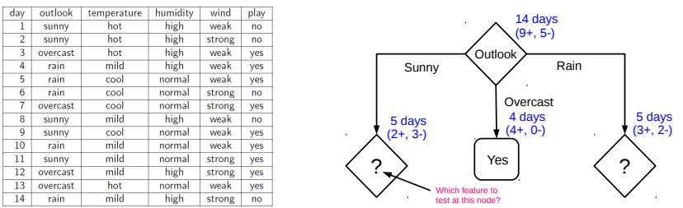
Growing the tree
26
Proceeding as before, for level 2, left node, we can verify that
IG(S,temp) = 0.570, IG(S, humidity) = 0.970, IG(S, wind) = 0.019
Thus humidity chosen as the feature to be tested at level 2, left node
No need to expand the middle node (already “pure” - all “yes” training examples )
Can also verify that wind has the largest IG for the right node
Note: If a feature has already been tested along a path earlier, we don’t consider it again

Slide 27
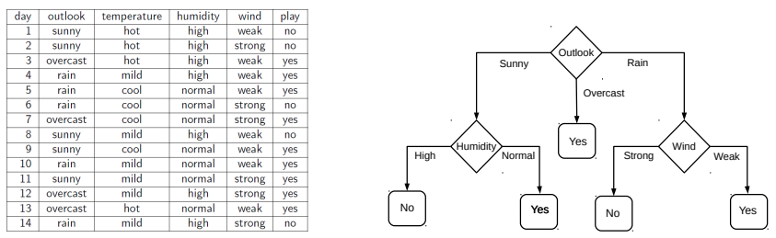
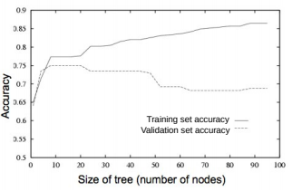
When to stop growing the tree?
27
Stop expanding a node further (i.e., make it a leaf node) when
It consist of all training examples having the same label (the node becomes “pure”)
We run out of features to test along the path to that node
The DT starts to overfit (can be checked by monitoring
the validation set accuracy)
Important: No need to obsess too much for purity
It is okay to have a leaf node that is not fully pure, e.g., this
At test inputs that reach an impure leaf, can predict probability of belonging to each class (in above example, p(red) = 3/8, p(green) = 5/8), or simply predict the majority label
To help prevent the tree from growing too much!
OR

Slide 29
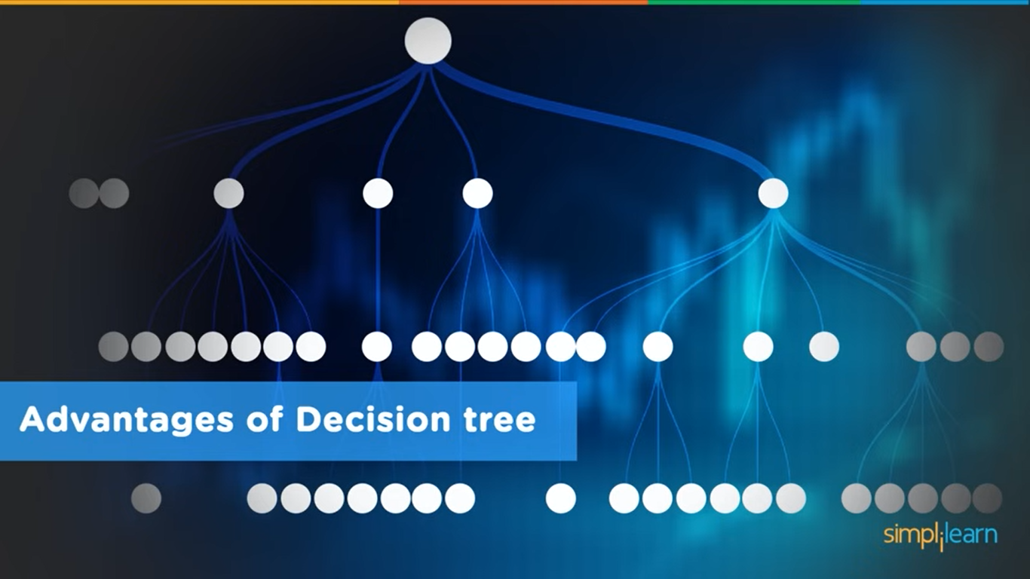

Slide 30
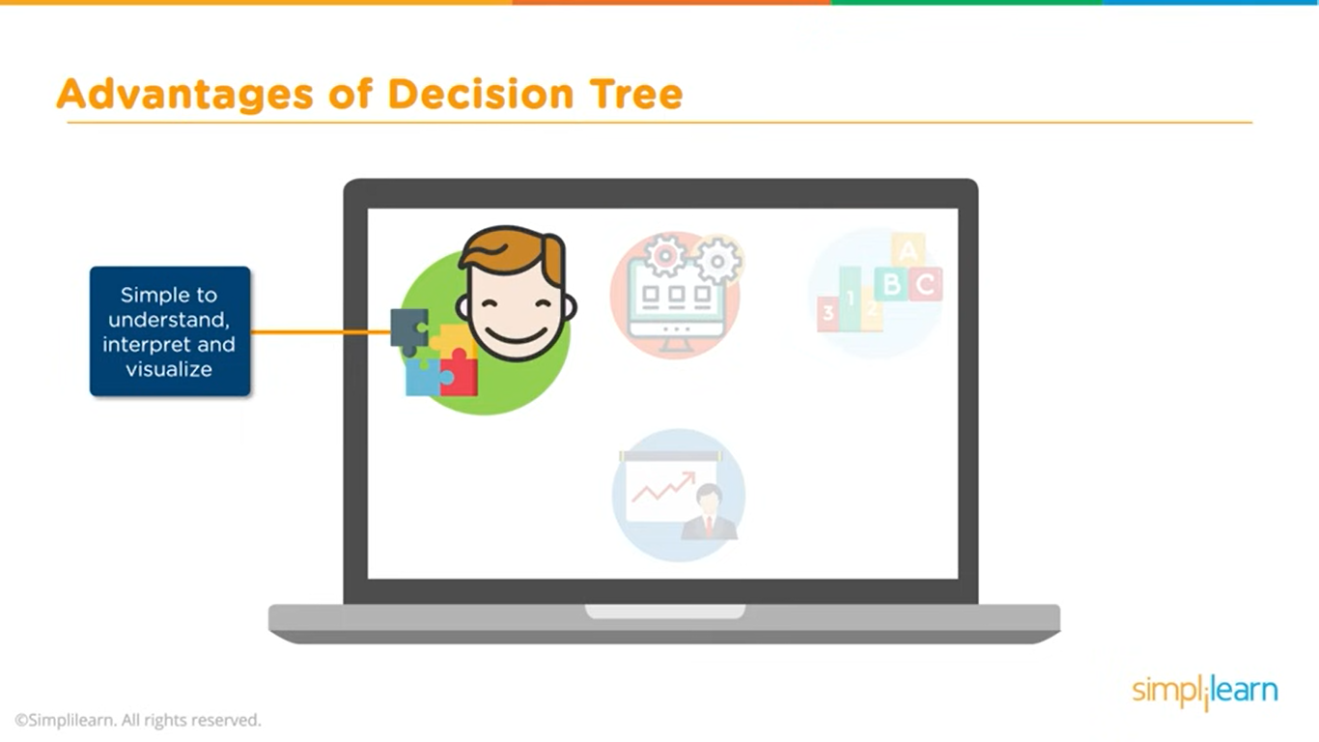

Slide 31
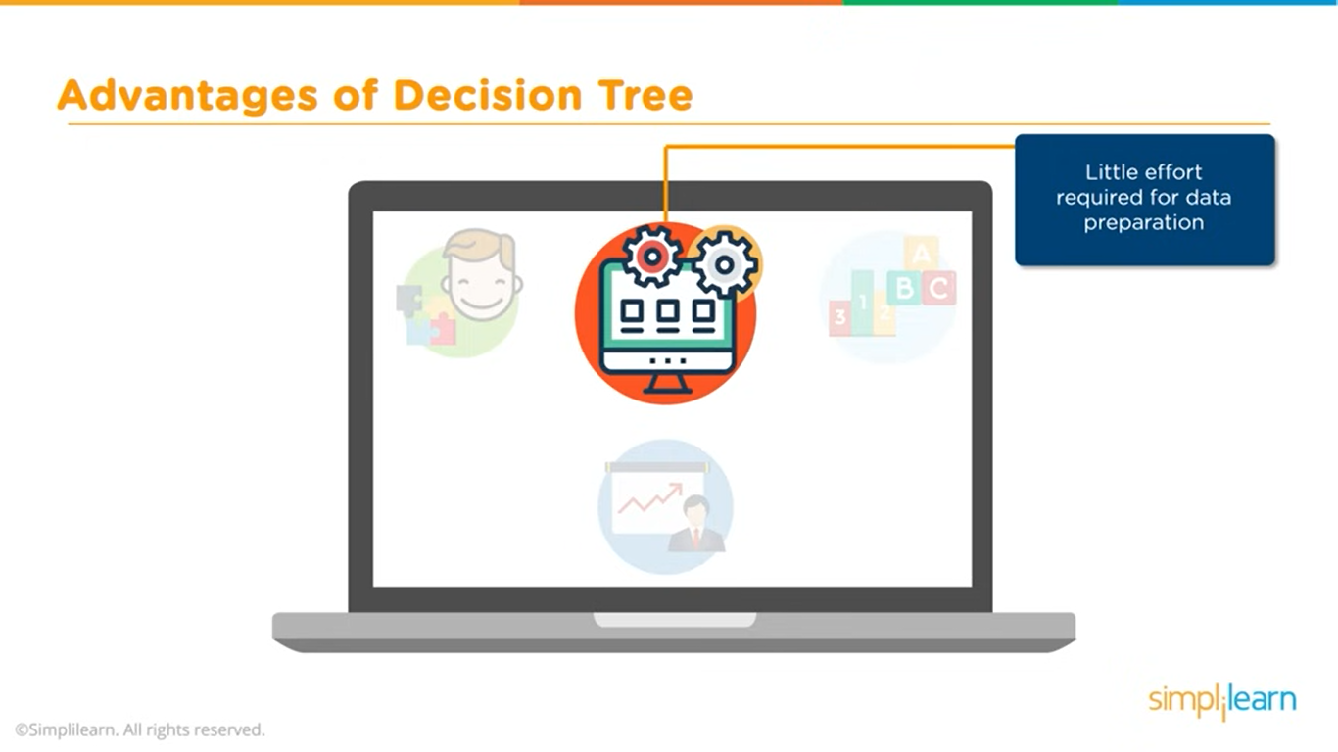

Slide 32
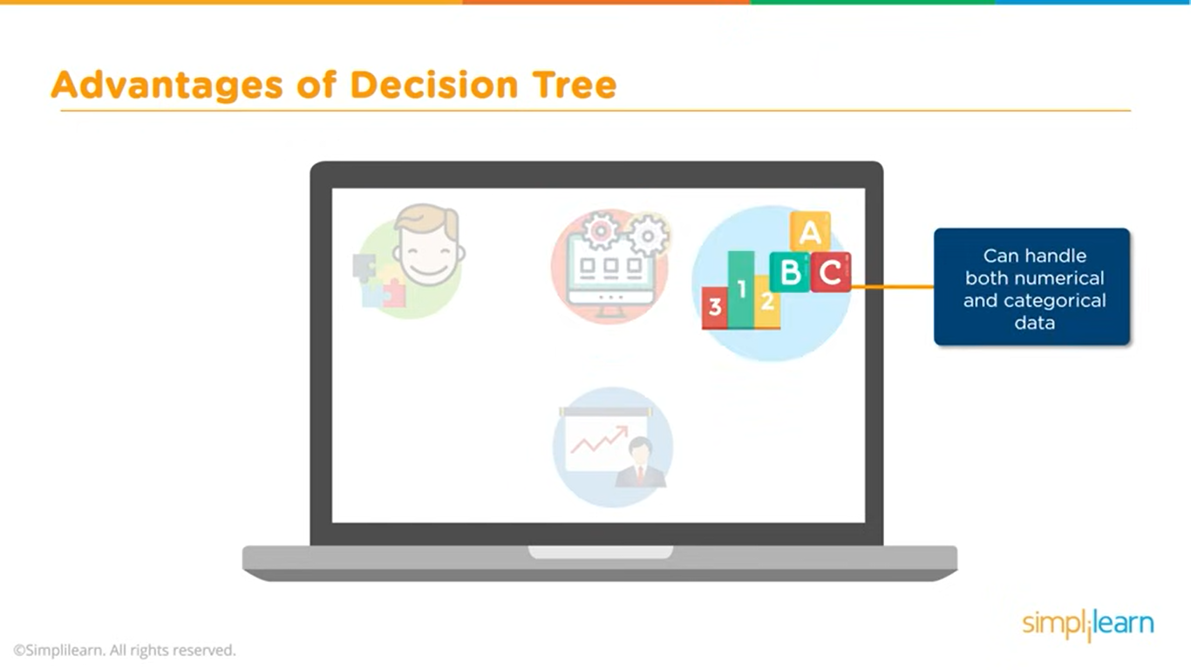

Slide 33
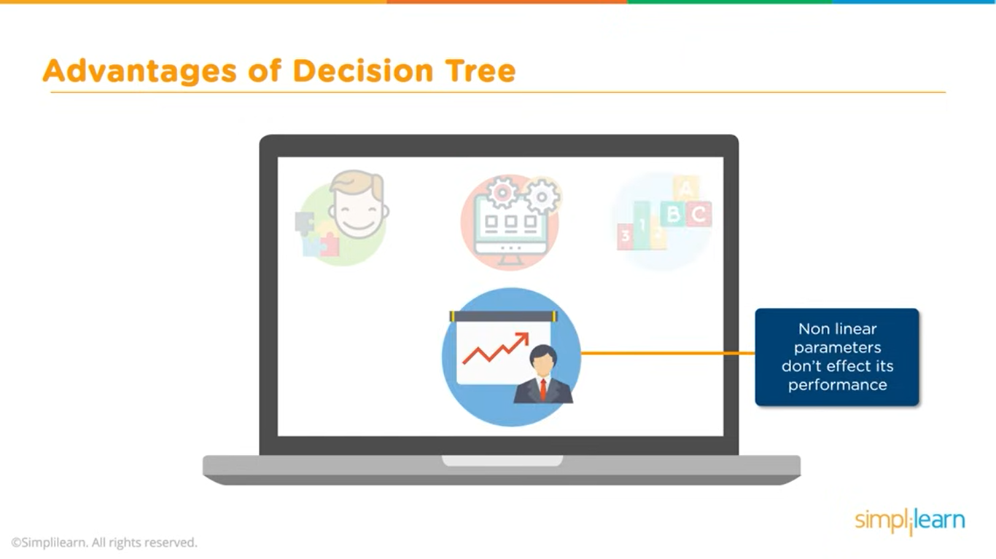

Slide 34
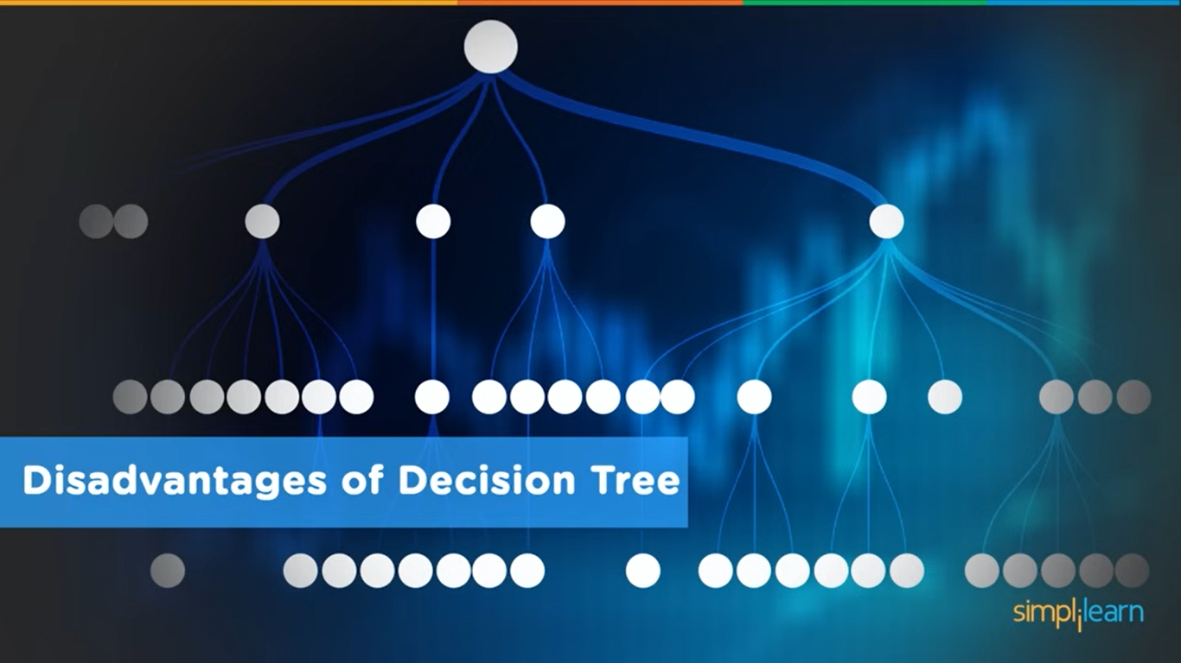

Slide 35
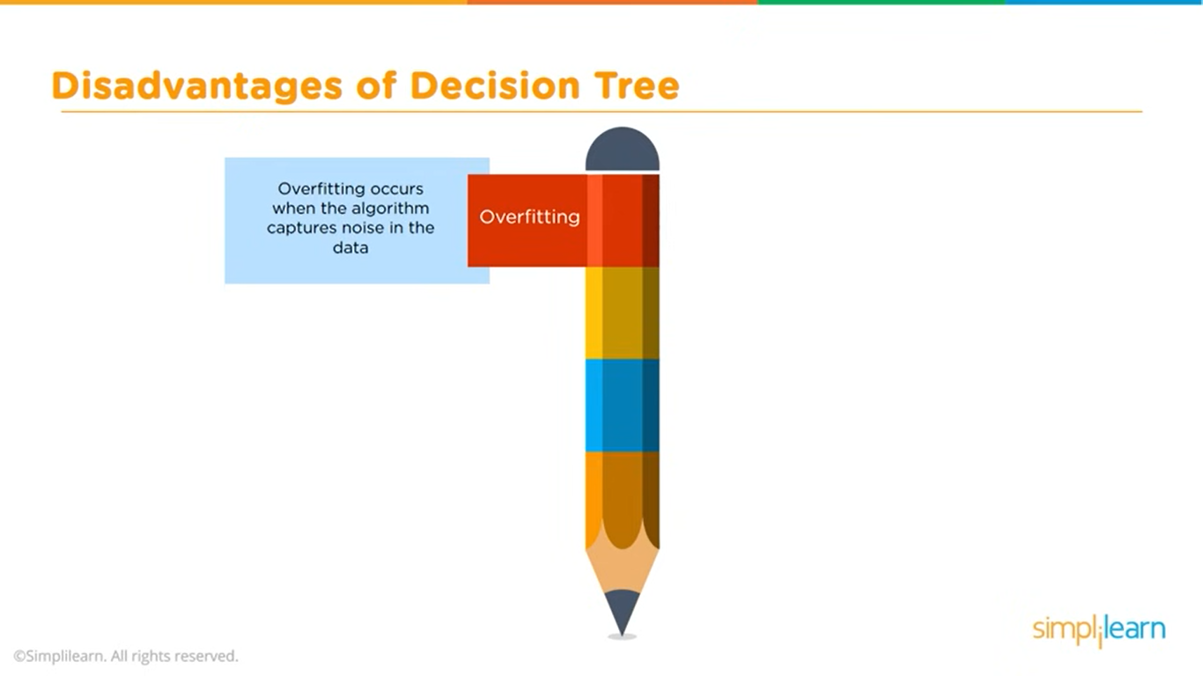

Slide 36
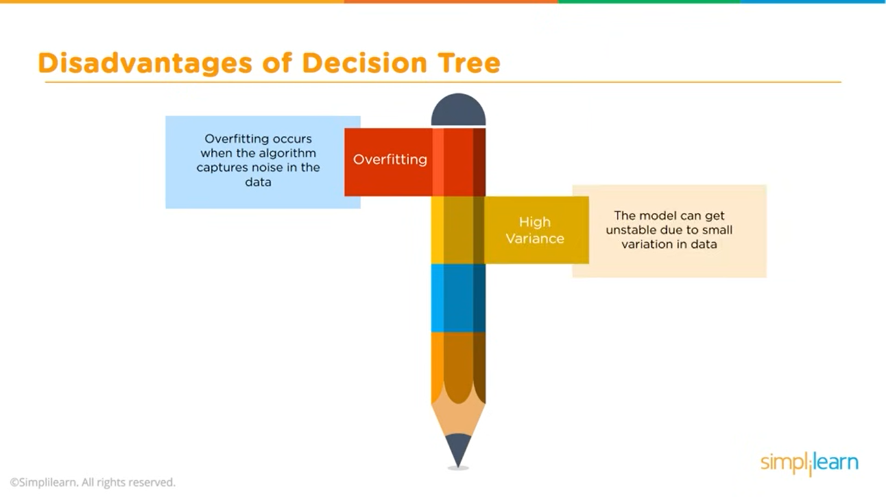

Slide 37
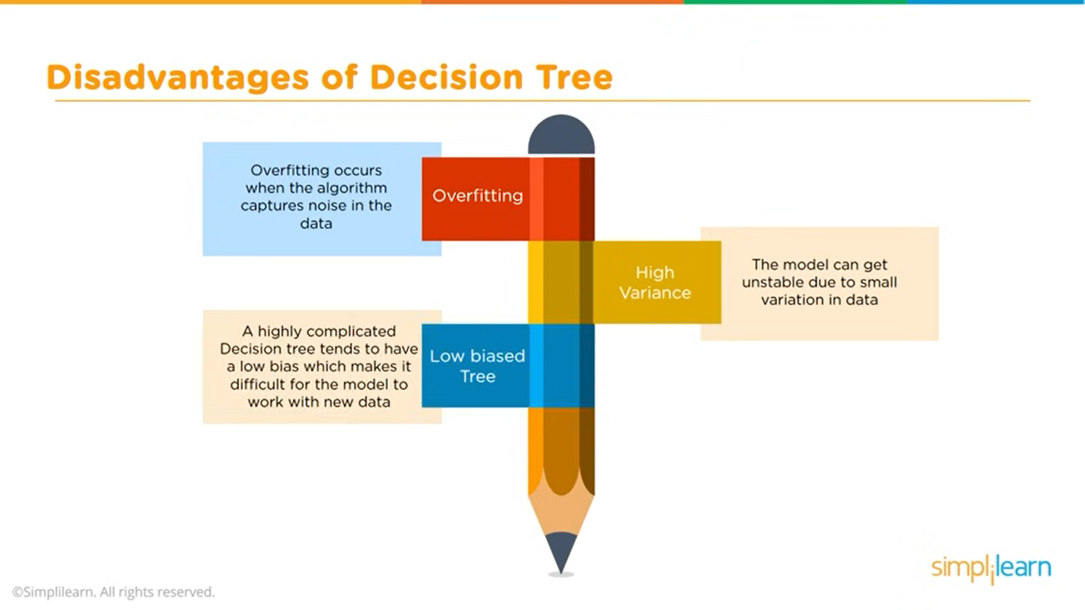

Slide 38
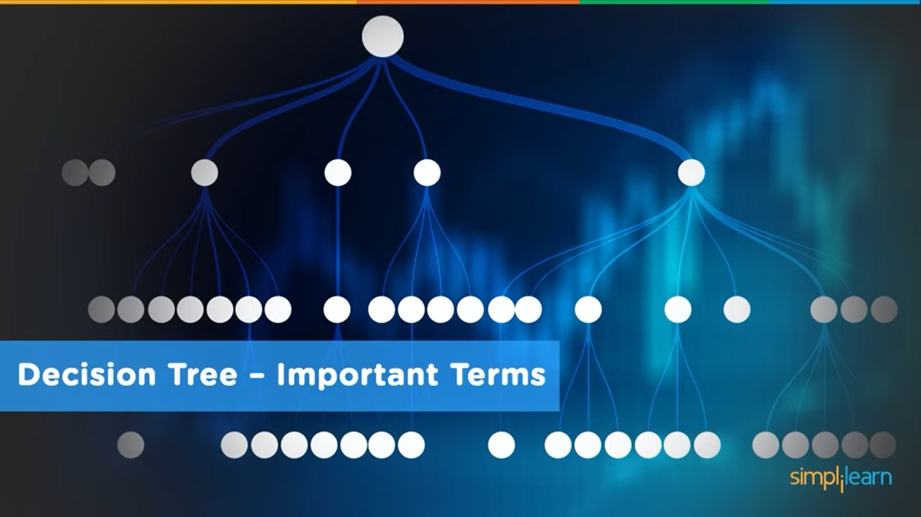

Slide 39
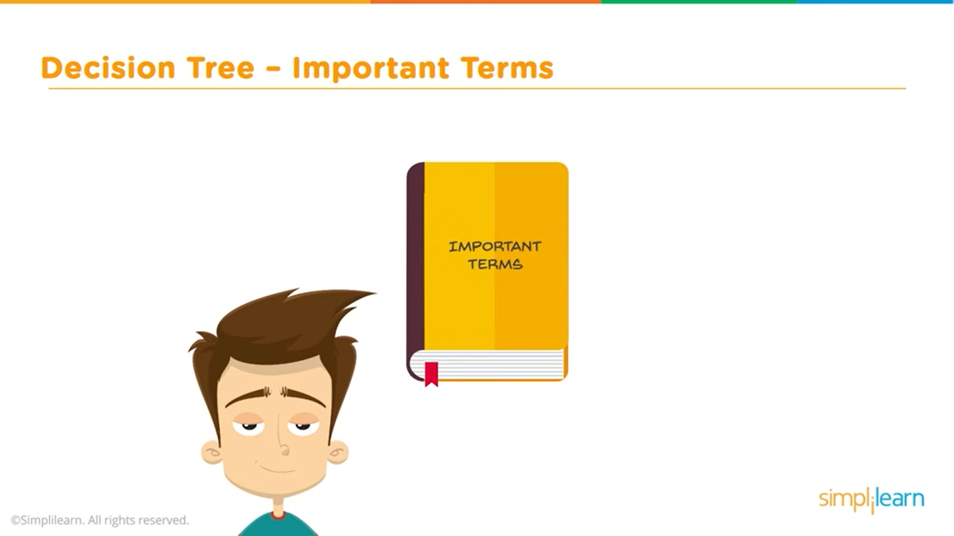

Slide 40
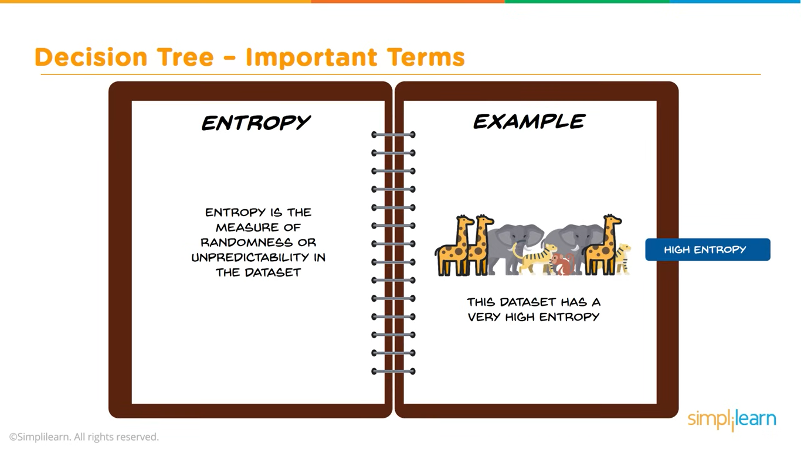

Slide 41
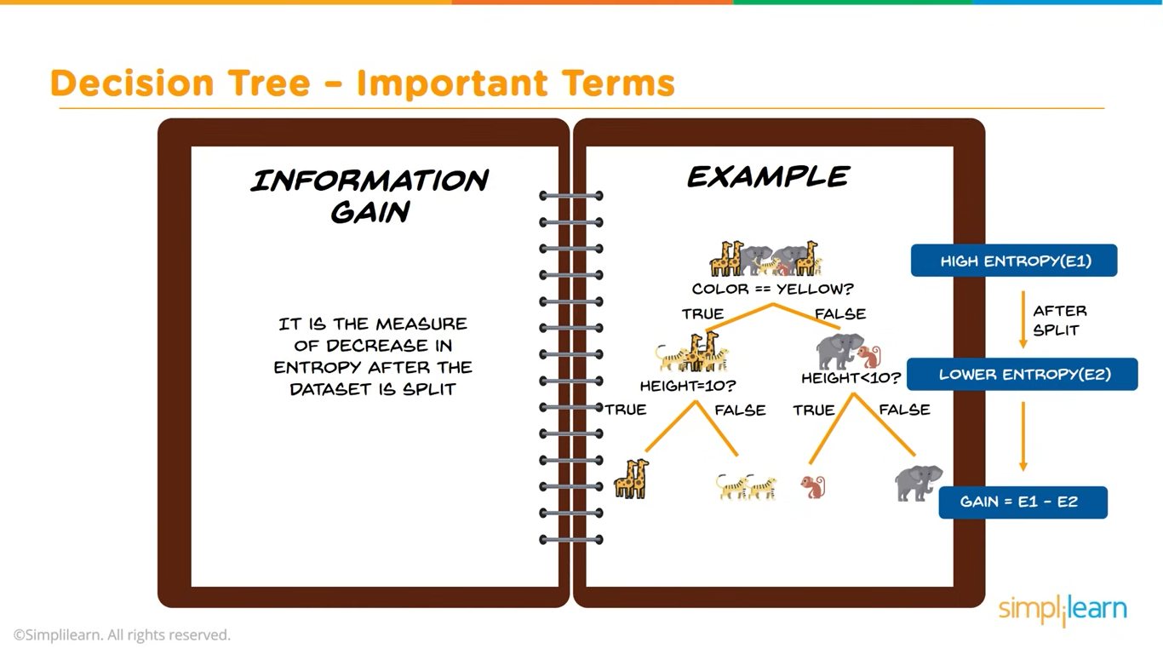

Slide 42
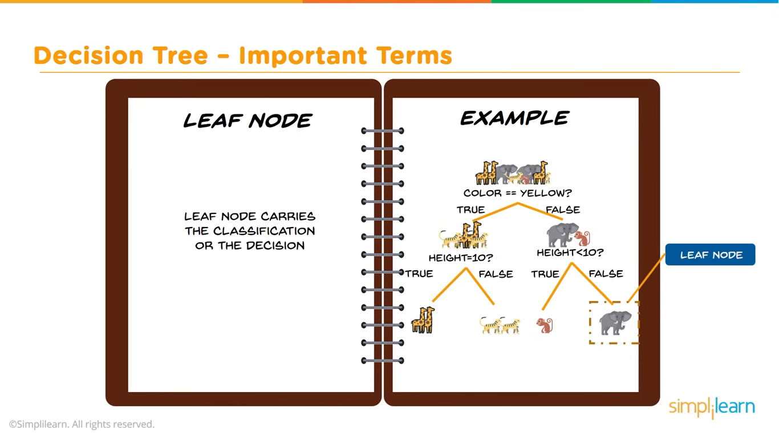

Slide 43
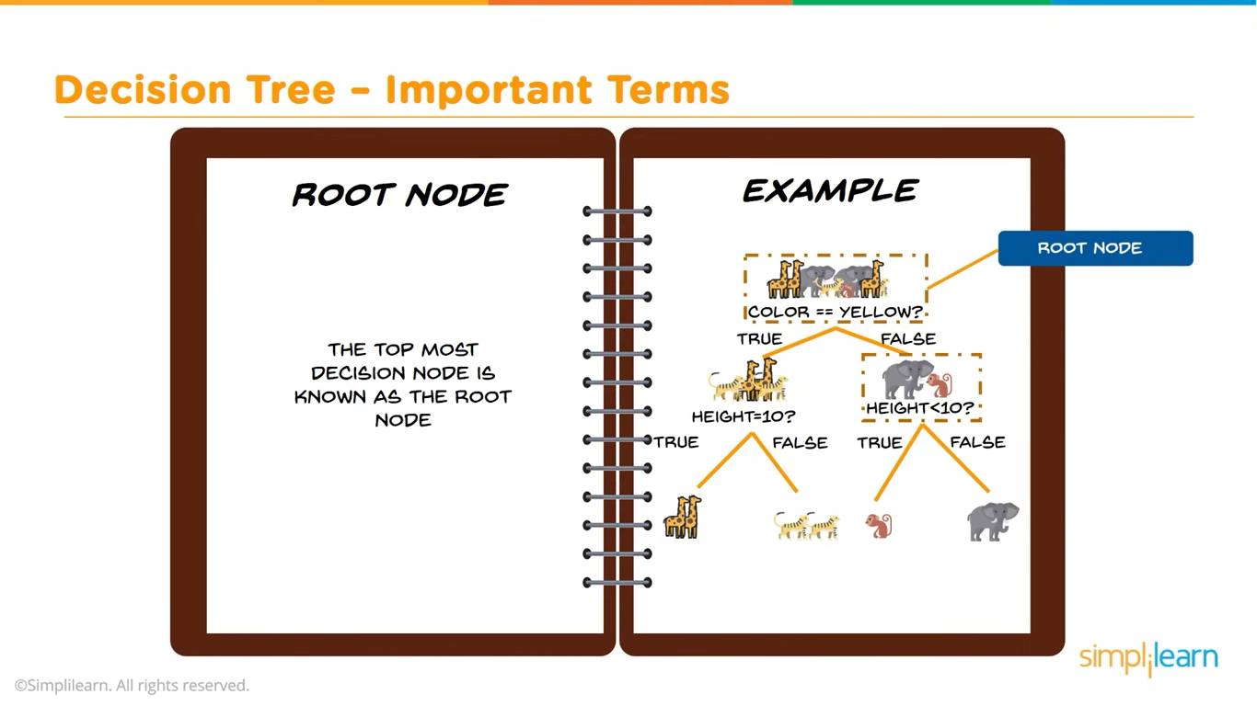

Slide 44
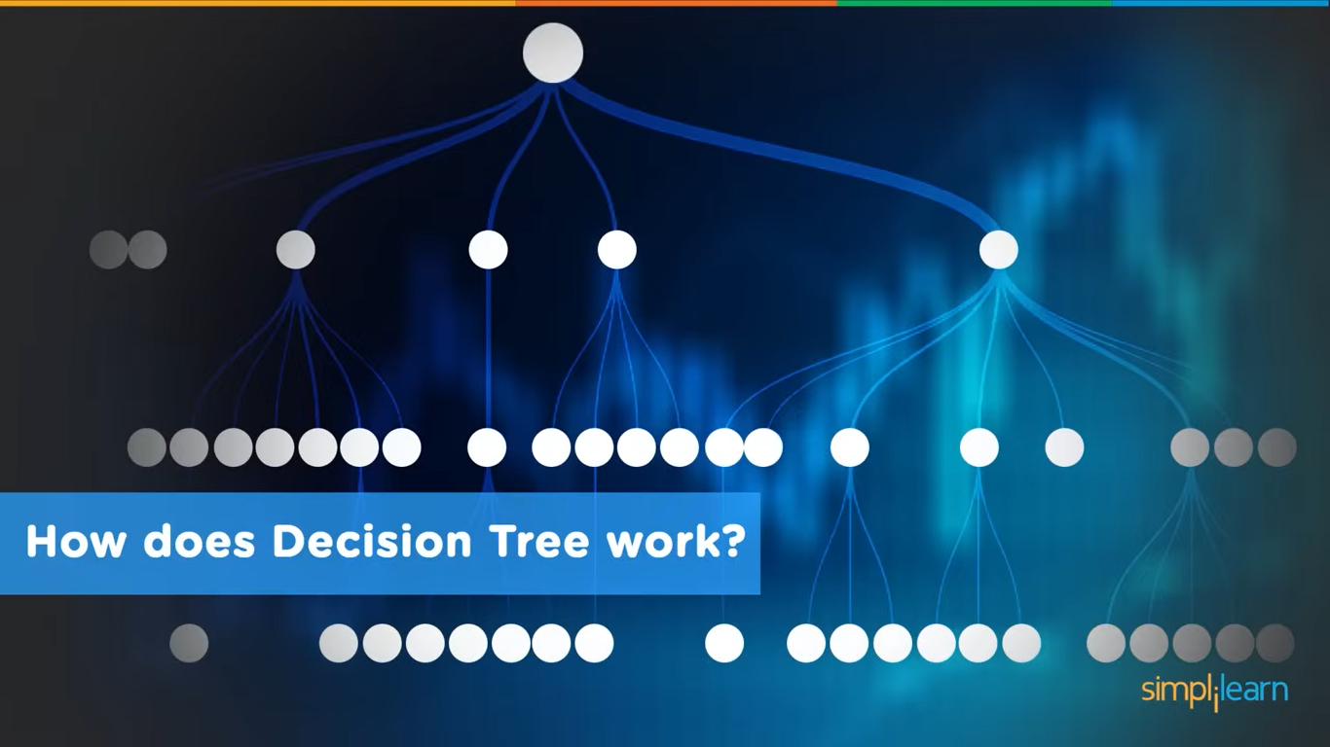

Slide 45
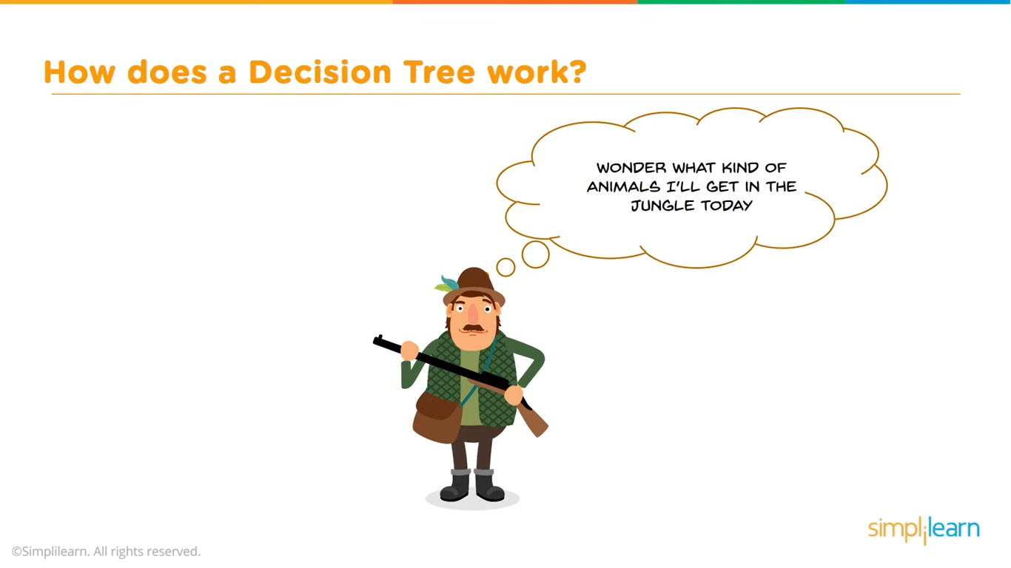

Slide 46
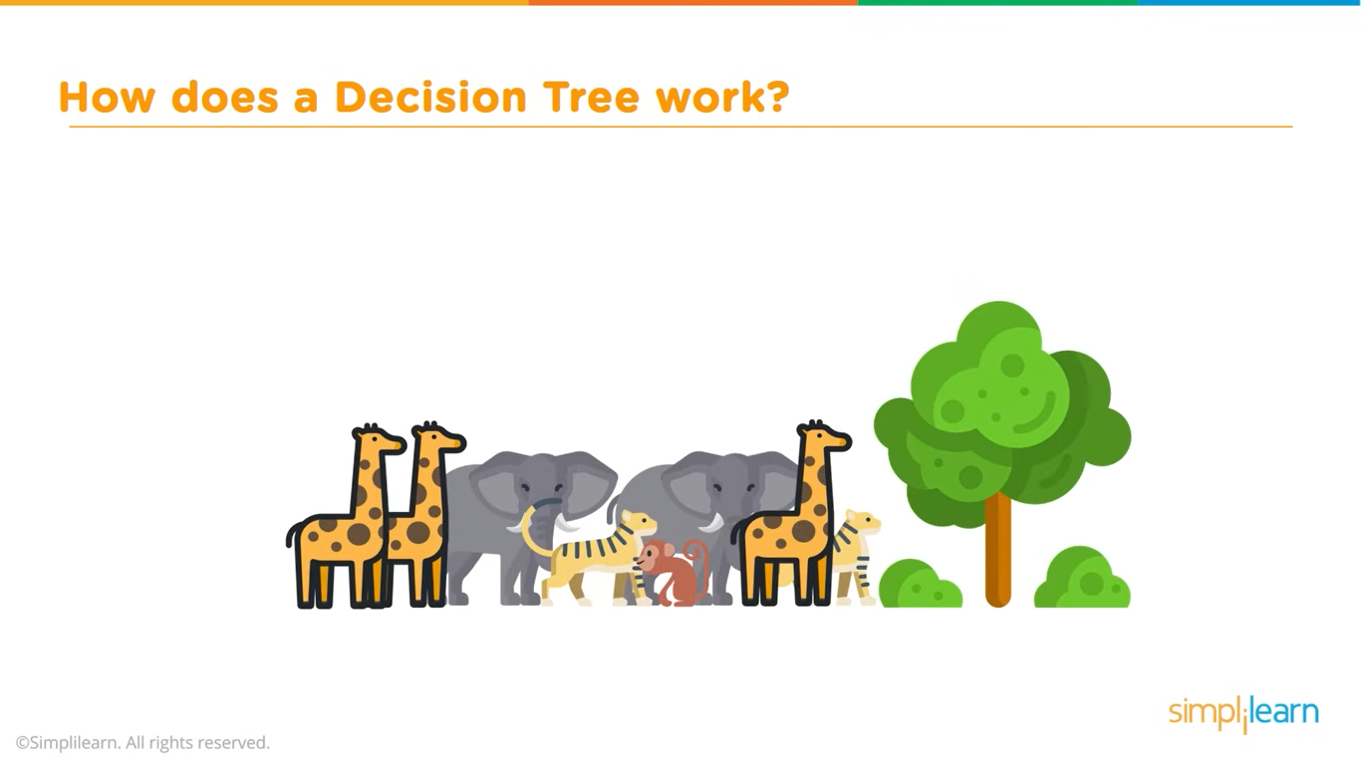

Slide 47
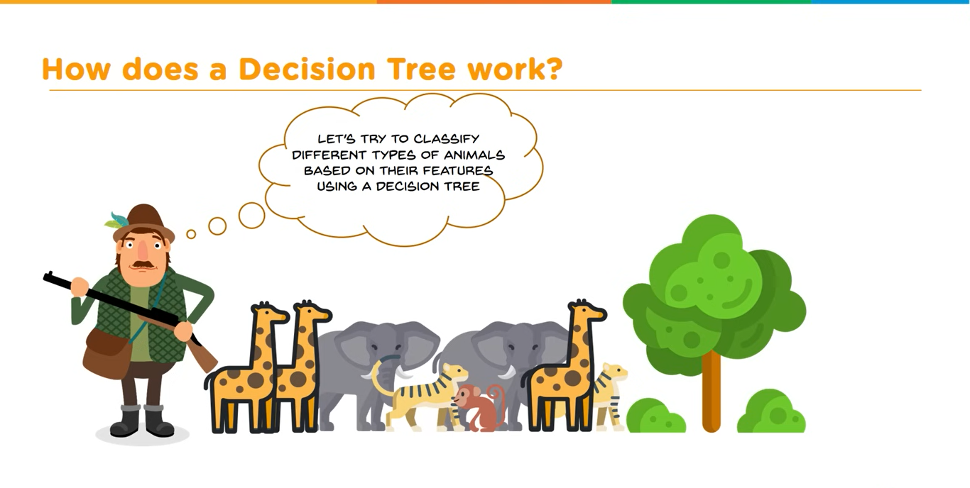

Slide 48
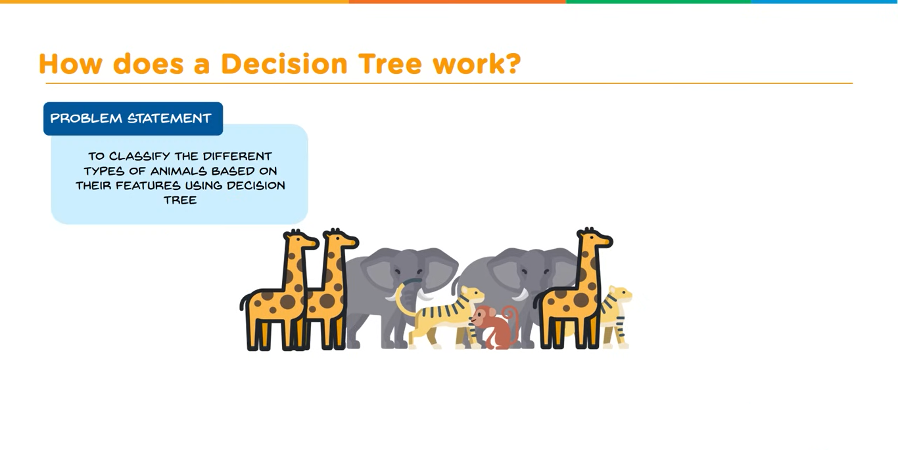

Slide 49
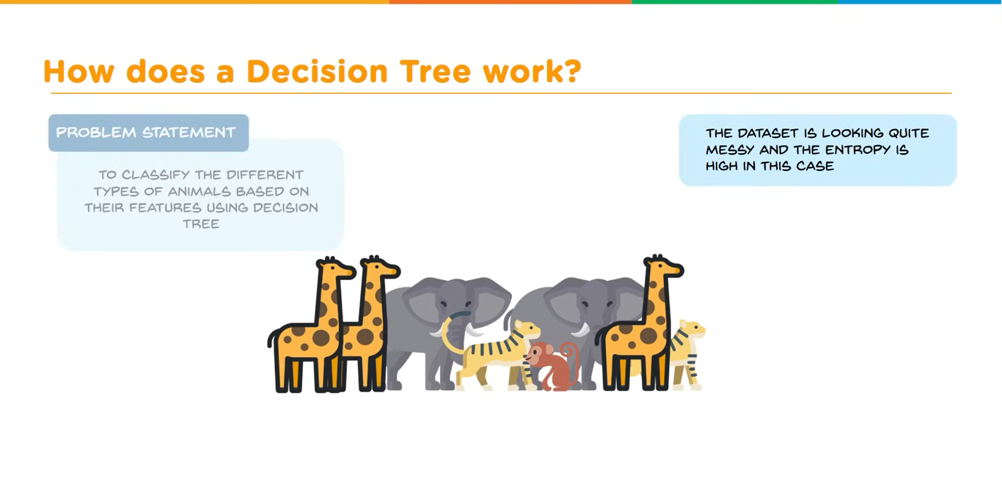

Slide 50
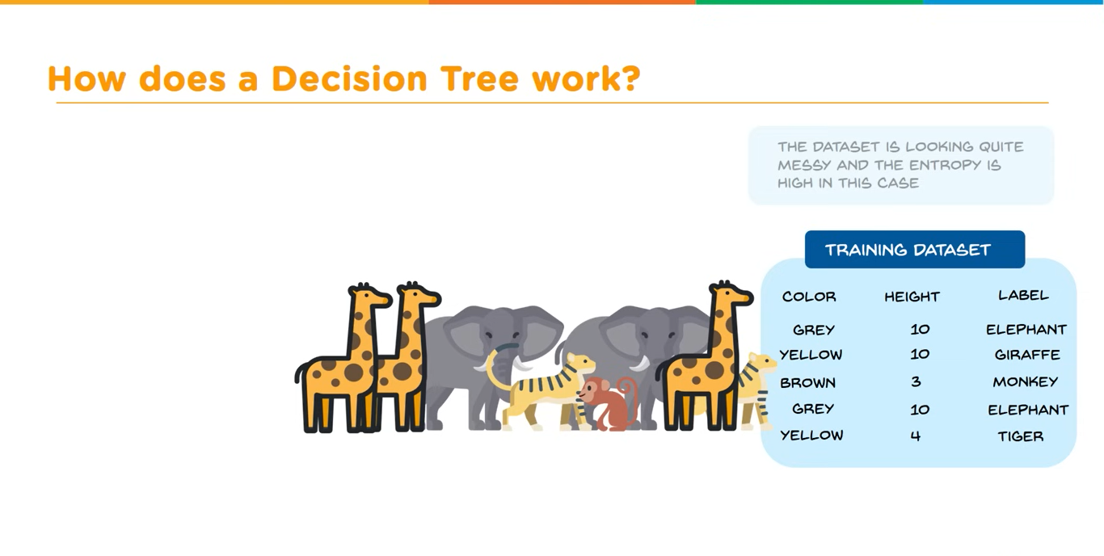

Slide 51
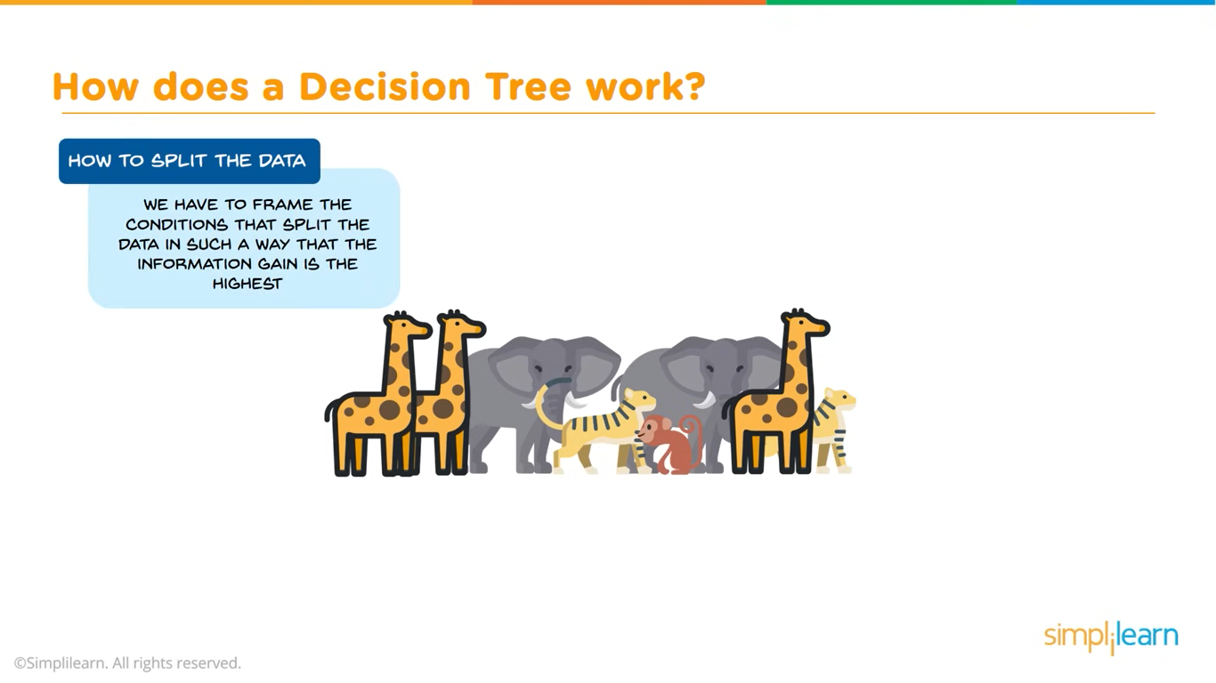

Slide 52
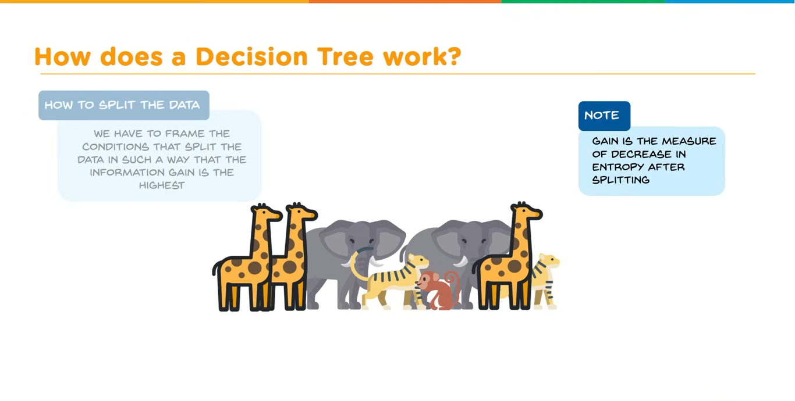

Slide 53


Slide 54


Slide 55


Slide 56


Slide 57


Slide 58


Slide 59


Slide 60


Slide 61


Slide 62


Slide 63


Slide 64


Slide 65


Slide 66


Slide 67


Slide 68
Python code for implementing Decision Tree using the popular scikit-learn library.
Steps to Implement:
Step 1: Import necessary libraries
Step 2: Load the dataset
Step 3: Exploratory Data Analysis (EDA) & Data Cleaning
Step 4: Split the dataset into training and testing sets
Step 5: Train the Decision Tree model
Step 6: Make predictions
Step 7: Evaluate the model
Step 8: Visualize the results

Slide 69
Split the dataset into training and testing sets

Slide 70

Train the Decision Tree model

Slide 71

Make predictions

Slide 72

Evaluate the model

Slide 73

To Visualize Decision Tree

Slide 74

Optimizing Decision Tree Performance

Slide 75

Evaluate the model

Slide 76
To Visualize Decision Tree

